Slide 1
Terraform, Jenkins and GitHub Actions
Training

Slide 2
Agenda
https://docs.google.com/document/d/1oVlTkaQyEzkeqdh-a7Qi5iZJExVBSeEP/edit?usp=sharing&ouid=108972485768906927376&rtpof=true&sd=

Slide 3
Training Format
Concepts
Hands-on exercises
Challenge/Assignments 15 to 20 min
Interactive

Slide 4
Timing
Start time at 11 am
Lunch - 1pm to 2pm
Break - 3 .30 pm
End at 5.30 pm

Slide 5
Lab Setup
Ubuntu VM and Configurations

Slide 6
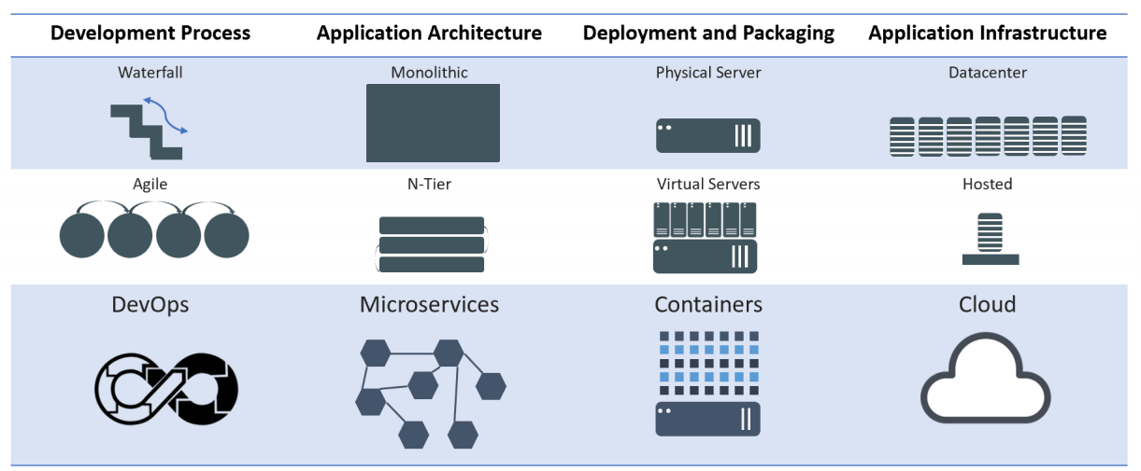
Evolution of Computing
Notes:
Mention WHY the evolution and benefits of adapting to new practices

Slide 7
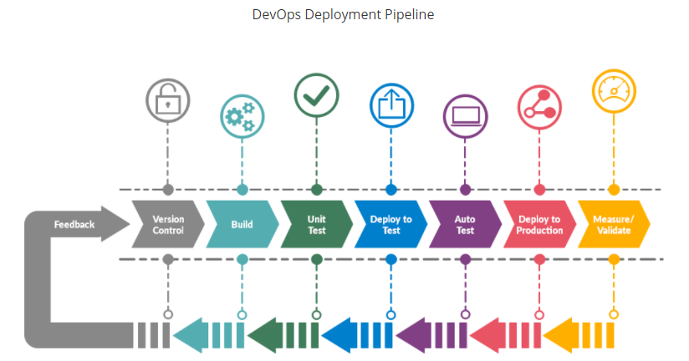

Slide 8
Infrastructure as code
Infrastructure as Code (IaC) is an approach to managing and provisioning infrastructure in a way that treats infrastructure configurations as code.
This means that you use code, typically in a declarative or imperative language, to define and automate the setup, configuration, and management of your infrastructure, including servers, networking, storage, and other resources

Slide 9
Why Infrastructure as code
Automation: IaC automates the provisioning, configuration, and management of infrastructure, reducing manual, error-prone tasks and ensuring consistency.
Version Control: Infrastructure code can be versioned, allowing for tracking changes, rollbacks, and collaboration among team members using tools like Git.
Scalability: IaC makes it easier to scale infrastructure resources up or down based on demand, adapting to changing workloads.
Reproducibility: With IaC, you can recreate entire environments reliably, ensuring consistency between development, testing, and production.
Documentation: Infrastructure code serves as documentation, making it easier to understand and maintain infrastructure configurations.

Slide 10
Why Infrastructure as code
Collaboration: Teams can work together on infrastructure code, enabling collaboration between developers and operations personnel.
Cost Efficiency: IaC can help optimize resource allocation and reduce wastage by defining infrastructure requirements more precisely.
Security: Security policies and best practices can be codified and enforced in the infrastructure code, enhancing the security of your environment.
Portability: Infrastructure definitions can be used across different cloud providers or on-premises environments, promoting flexibility.
Change Management: IaC provides a structured approach to making changes to infrastructure, ensuring that modifications are planned and tracked.

Slide 11
Terraform
Terraform is an open-source Infrastructure as Code (IaC) tool developed by HashiCorp.
It is designed to help organizations manage and provision infrastructure resources in a declarative and automated way.
Terraform allows you to define, configure, and version your infrastructure using a domain-specific language or HashiCorp Configuration Language (HCL).

Slide 12
Why Terraform
Declarative Syntax: Terraform uses a declarative syntax to define the desired state of your infrastructure. You specify what resources you need, their configurations, and their dependencies, without specifying how to achieve that state.
Providers: Terraform supports a wide range of cloud providers (e.g., AWS, Azure, Google Cloud), as well as other infrastructure components like databases, networking, and more. These providers allow you to interact with various services and resources.
State Management: Terraform maintains a state file that keeps track of the current state of your infrastructure. This state file is used to plan and apply changes while ensuring that the desired state matches the actual state.
Execution Plans: Terraform generates an execution plan before making any changes to your infrastructure. This plan outlines what actions will be taken, such as creating, updating, or destroying resources, without applying the changes immediately.

Slide 13
Why Terraform
Modularity: Terraform encourages the use of reusable modules. Modules are a way to encapsulate and share infrastructure configurations, making it easier to maintain and standardize infrastructure setups.
Version Control Integration: Terraform configurations can be stored in version control systems like Git, enabling collaboration, change tracking, and rollback capabilities.
Community and Ecosystem: Terraform has a large and active community, and a vast ecosystem of third-party modules and plugins, making it a popular choice for IaC.
Extensibility: Terraform's extensible architecture allows you to write custom providers and provisioners to interact with specific APIs or perform custom actions.

Slide 14
Why Terraform better than other IAC tools
Multi-Cloud Support: Terraform is known for its extensive support for various cloud providers, making it a great choice for organizations that operate across multiple cloud platforms. It provides a consistent way to manage infrastructure across different environments.
HCL Syntax: Terraform uses the HashiCorp Configuration Language (HCL), which many find easy to read and write. The declarative syntax of HCL allows you to express your infrastructure requirements clearly and concisely.

Slide 15
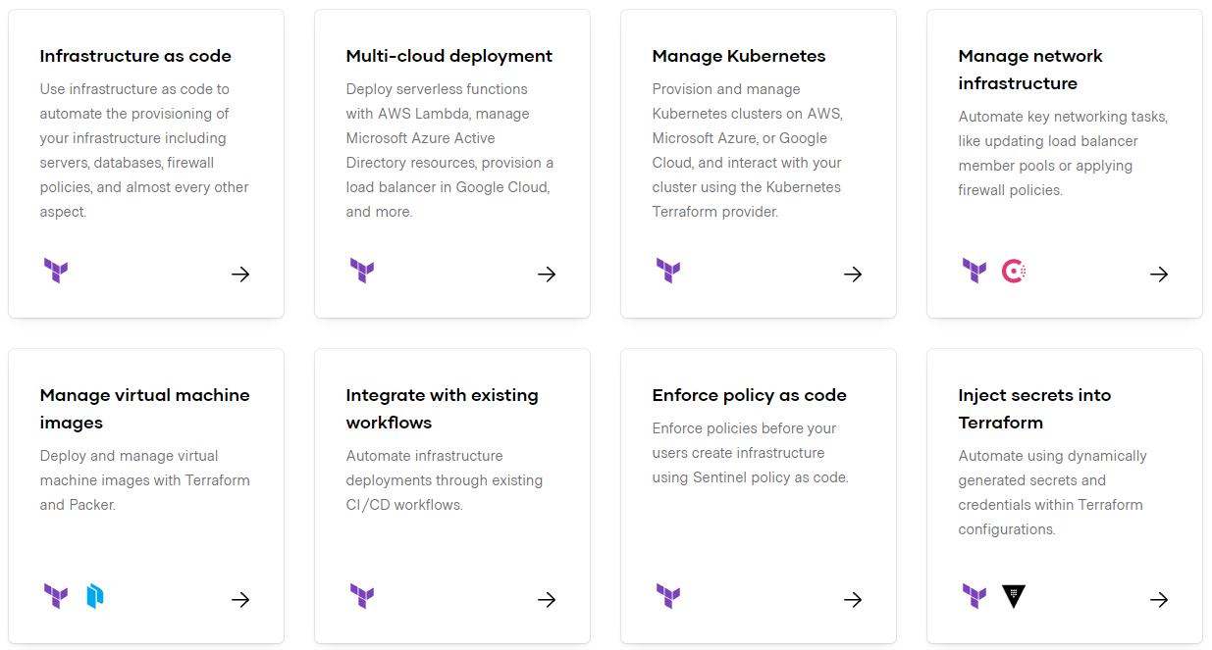
https://www.terraform.io/

Slide 16
Installation
https://developer.hashicorp.com/terraform/install

Slide 17
Exercise 1: Configure AWS CLI

Slide 18
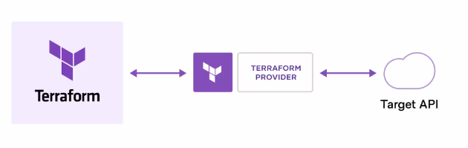
How does Terraform work?
Terraform creates and manages resources on cloud platforms and other services through their application programming interfaces (APIs). Providers enable Terraform to work with virtually any platform or service with an accessible API.
https://registry.terraform.io/

Slide 19
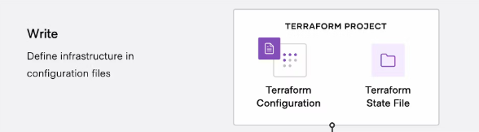
Terraform workflow stages: Write
You define resources, which may be across multiple cloud providers and services. For example, you might create a configuration to deploy an application on virtual machines in a Virtual Private Cloud (VPC) network with security groups and a load balancer.

Slide 20
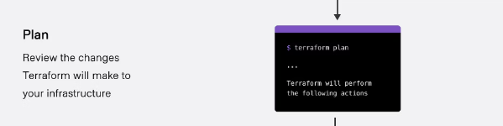
Terraform workflow stages: Plan
Terraform creates an execution plan describing the infrastructure it will create, update, or destroy based on the existing infrastructure and your configuration.

Slide 21
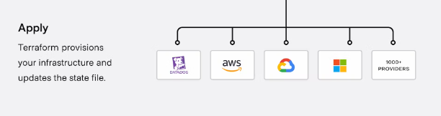
Terraform workflow stages: Apply
On approval, Terraform performs the proposed operations in the correct order, respecting any resource dependencies. For example, if you update the properties of a VPC and change the number of virtual machines in that VPC, Terraform will recreate the VPC before scaling the virtual machines.

Slide 22
Terraform HCL
HCL stands for HashiCorp Configuration Language. It is a domain-specific language (DSL) developed by HashiCorp, the company behind popular infrastructure-as-code tools like Terraform, Consul, Vault, and Packer.
HCL is used primarily for defining configurations and infrastructure in a human-readable and machine-friendly format.
HCL is designed to be easy to read and write and is used in various HashiCorp tools for defining configuration files. Some of the key features and characteristics of HCL include:
1. Declarative Syntax: HCL is a declarative language, which means you specify what you want your infrastructure to look like, and the underlying tools (e.g., Terraform) figure out how to make it happen.

Slide 23
Terraform HCL
2. Block Structure: HCL uses a block structure, with nested blocks and attributes, to define configurations. This helps maintain a clear and structured organization of configuration files.
3. Human-Readable: HCL is designed to be easily readable and writable by both humans and machines, which makes it accessible to infrastructure and DevOps engineers.
4. Variable Support: HCL supports variables, which can be used to parameterize your configuration and make it more flexible and reusable.

Slide 24
Terraform HCL
5. Interpolation: HCL allows for variable interpolation, where you can reference variables within other parts of your configuration.
6. Comments: HCL supports both single-line (`#`) and multi-line (`/* */`) comments, which are helpful for documentation and annotation.
7. Support for Multiple HashiCorp Tools: While HCL is most commonly associated with Terraform, it is also used in other HashiCorp tools like Consul, Nomad, Vault, and Packer, providing a consistent configuration language across the HashiCorp ecosystem.

Slide 25
Resources and Providers
Resources: Infrastructure components like EC2 instances, S3 buckets, databases, etc.
Providers: Plugins that enable Terraform to interact with cloud services (AWS, Azure, GCP, etc.)
Example:
provider "aws" {
region = "us-east-1"
}
resource "aws_instance" "example" {
ami = "ami-0c55b159cbfafe1f0"
instance_type = "t2.micro"
}
https://registry.terraform.io/browse/providers

Slide 26
Terraform State Files
State files track the infrastructure Terraform manages
Stored as terraform.tfstate
Helps Terraform understand the current state of resources
Allows tracking of changes between executions
Example: Terraform applies changes based on the difference between the state file and the actual cloud infrastructure

Slide 27
Desired vs. Current Infrastructure
Desired State: Defined in the Terraform configuration files
Current State: Actual deployed infrastructure
Terraform Workflow:
Write Configuration (Define desired state)
Plan (Compare with current state)
Apply (Make changes to match the desired state)
Destroy (Cleanup resources if needed)
Example: If an EC2 instance is removed from configuration, Terraform will destroy it during terraform apply

Slide 28
Terraform Basic Commands
terraform init – Initializes a Terraform working directory
terraform plan – Shows what changes will be made without applying them
terraform apply – Creates or updates infrastructure
terraform destroy – Destroys all managed resources
terraform show – Displays the current state of resources
terraform output – Extracts values from the Terraform state
terraform fmt – Formats Terraform configuration files for readability

Slide 29
Exercise 2: Provisioning an AWS EC2 Instance with Terraform

Slide 30
Assignment 1: Provision a CentOS VM in AWS Using Terraform
Task:
Use Terraform to provision a CentOS EC2 instance in the ap-southeast-2 (Sydney) region.
Use an appropriate CentOS AMI for the region.
Set the instance type to t2.micro.
Add multiple tags (e.g., Name = "CentOS-Server", Environment = "Development", Owner = "YourName").
After deployment, run terraform show and provide the output.

Slide 31
Assignment 2: Provision a Windows VM in AWS Using Terraform
Task:
Use Terraform to provision a Windows EC2 instance in your region.
Choose a valid Windows AMI and set the instance type to t2.medium.
Configure RDP access (port 3389) via a security group.
Assign multiple tags (e.g., Name = "Windows-VM", Department = "IT", Owner = "YourName").

Slide 32
Exercise 3: Exercise 3: Organizing Terraform Code for AWS EC2 Provisioning
✔ Moving the terraform block to a separate file (versions.tf)
✔ Moving the provider block to a separate file (provider.tf)
✔ Creating a variables.tf file to manage variables
✔ Creating an outputs.tf file to store output values
✔ Keeping the EC2 instance resource definition in main.tf

Slide 33
Exercise : Provisioning an AWS EC2 Instance with Terraform (Full Infrastructure Setup)
provisioning an AWS EC2 instance using Terraform, from scratch. You will create all necessary networking components, storage, security, key pair, and EC2 instance, and structure them into separate files for better modularity.

Slide 34
Assignment: Provision an AWS S3 Bucket and Perform Operations Using Terraform
Task:
Create an S3 bucket using Terraform.
Enable versioning for the bucket.
Upload a sample file (sample.txt) to the bucket using Terraform.
Define an output to display the S3 bucket URL.

Slide 35
Terraform Variables
What are Terraform Variables?
Terraform variables allow dynamic values in configurations.
Improve reusability, modularity, and flexibility in infrastructure management.
Defined using the variable block in Terraform.
Types of Variables in Terraform:
Input Variables (variable) – User-defined values.
Local Variables (locals) – Used within a module to simplify expressions.
Environment Variables (TF_VAR_name) – Set via the OS environment.
Output Variables (output) – Display values after execution.

Slide 36
Defining and Using Input Variables
Defining Variables in variables.tf
variable "instance_type" {
description = "EC2 instance type"
type = string
default = "t2.micro"
}
Assigning Variable Values:
Default values (inside variables.tf).
Using terraform.tfvars file:
instance_type = "t3.micro"

Slide 37
String and Number
variable "instance_name" {
description = "Name of the EC2 instance"
type = string
default = "Terraform-VM"
}
variable "volume_size" {
description = "Root volume size in GB"
type = number
default = 20
}

Slide 38
Bool and List
variable "enable_monitoring" {
description = "Enable monitoring for the EC2 instance"
type = bool
default = true
}
variable "security_groups" {
description = "List of security group IDs"
type = list(string)
default = ["sg-12345", "sg-67890"]
}

Slide 39
map
variable "additional_tags" {
description = "Additional tags for the instance"
type = map(string)
default = {
environment = "dev"
owner = "admin"
}
}

Slide 40
Object
variable "network_config" {
description = "Network configuration settings"
type = object({
subnet_id = string
assign_public_ip = bool
})
default = {
subnet_id = "subnet-abc123"
assign_public_ip = true
}
}

Slide 41
Defining and Using Input Variables
Passing via CLI:
terraform apply -var="instance_type=t3.micro"
Using environment variables:
export TF_VAR_instance_type="t3.micro"
terraform apply

Slide 42
Locals
A local value assigns a name to an expression, so you can use the name multiple times within a module instead of repeating the expression.
If you're familiar with traditional programming languages, it can be useful to compare Terraform modules to function definitions:
Input variables are like function arguments.
Output values are like function return values.
Local values are like a function's temporary local variables.

Slide 43
Locals
locals {
service_name = "forum"
owner = "Community Team"
}

Slide 44
Locals
locals {
# Ids for multiple sets of EC2 instances, merged together
instance_ids = concat(aws_instance.blue.*.id, aws_instance.green.*.id)
}
locals {
# Common tags to be assigned to all resources
common_tags = {
Service = local.service_name
Owner = local.owner
}
}

Slide 45
HCL
count:
The count parameter is used to create multiple instances of a resource.
Interpolation:
Interpolation syntax ${} is used to dynamically generate unique bucket names like my-bucket-0, my-bucket-1, etc.
It’s also used in the tags to create unique names for each resource.

Slide 46
HCL continues
depends_on:
The depends_on meta-argument is used in the aws_iam_user_policy_attachment resource to ensure the IAM user is created before attaching the policy.
Parallel Execution:
Terraform inherently runs resources in parallel when possible. The S3 buckets in my_parallel_bucket are created independently of the my_bucket buckets, showcasing Terraform's parallel execution capabilities.

Slide 47
Terraform console
This command provides an interactive command-line console for evaluating and experimenting with expressions.
You can use it to test interpolations before using them in configurations and to interact with any values currently saved in state.
If the current state is empty or has not yet been created, you can use the console to experiment with the expression syntax and built-in functions.
The console holds a lock on the state, and you will not be able to use the console while performing other actions that modify state.
To close the console, enter the exit command or press Control-C or Control-D.
$ terraform console

Slide 48
Expressions
Expressions refer to or compute values within a configuration. The simplest expressions are just literal values, like "hello" or 5, but the Terraform language also allows more complex expressions such as references to data exported by resources, arithmetic, conditional evaluation, and a number of built-in functions.
https://developer.hashicorp.com/terraform/language/expressions

Slide 49
Terraform Expressions
Expressions are used to compute values dynamically within Terraform.
They can be used in variables, resources, outputs, and modules.
Help make configurations more flexible and reusable.

Slide 50
Types of Terraform Expressions
Literal Values (Strings, Numbers, Booleans, Lists, Maps)
References (Variables, Resources, Data Sources)
Functions (Built-in Terraform Functions)
Operators (Arithmetic, Comparison, Logical)
Conditional Expressions
For Expressions

Slide 51
Exercise: Expression usage

Slide 52
Terraform Assignment: Apply Terraform Expressions to Provision an S3 Bucket
Objective:
Use Terraform expressions (variables, functions, operators, conditionals, and loops) to create an S3 bucket with dynamic configurations.
Assignment Tasks:
1️⃣ Define Input Variables:
Create variables for bucket name, environment (dev/stage/prod), versioning, and tags.
Use default values where applicable.
2️⃣ Use Conditional Expressions:
Enable versioning only for stage and prod environments.
3️⃣ Use for Expressions to Generate Tags:
Define a map of tags and iterate over it using a for expression.

Slide 53
Terraform Assignment: Apply Terraform Expressions to Provision an S3 Bucket
4️⃣ Use Terraform Functions:
Convert the bucket name to lowercase using lower().
Generate a random suffix using random_string resource.
5️⃣ Create the S3 Bucket:
Apply dynamic naming by appending a random suffix to the bucket name.
Use Terraform expressions to set lifecycle rules (delete objects after X days).
Expected Output:
After completing the assignment, your Terraform configuration should:
✅ Dynamically create an S3 bucket with a unique name.
✅ Enable versioning conditionally based on the environment.
✅ Assign dynamic tags using for expressions.
✅ Use Terraform functions to format data.
✅ Apply lifecycle policies using expressions.

Slide 54
Functions
The Terraform language includes a number of built-in functions that you can call from within expressions to transform and combine values. The general syntax for function calls is a function name followed by comma-separated arguments in parentheses:
max(5, 12, 9)
https://developer.hashicorp.com/terraform/language/functions

Slide 55
Functions
Terraform provides built-in functions to manipulate and compute values.
Functions help in string manipulation, numeric operations, collections, and date handling.
They make configurations more dynamic and reusable.

Slide 56
Functions
Terraform functions are grouped into the following categories:
String Functions (Manipulate text values)
Numeric Functions (Perform calculations)
Collection Functions (Work with lists and maps)
Date and Time Functions (Handle timestamps)
Encoding Functions (Convert data formats)
Filesystem Functions (Read files dynamically)

Slide 57
String Functions
Used for modifying and formatting text.
Examples:
upper("hello") → "HELLO"
lower("HELLO") → "hello"
length("terraform") → 9
replace("Terraform", "form", "ing") → "Terraforming"

Slide 58
Numeric Functions
Used for mathematical operations.
Examples:
abs(-10) → 10 (Absolute value)
max(5, 10, 3) → 10 (Largest number)
min(5, 10, 3) → 3 (Smallest number)
floor(3.8) → 3 (Round down)
ceil(3.2) → 4 (Round up)

Slide 59
Collection Functions
Used for working with lists and maps.
Examples:
length(["apple", "banana", "cherry"]) → 3
join(", ", ["AWS", "Azure", "GCP"]) → "AWS, Azure, GCP"
lookup({name="Terraform", type="IAC"}, "type", "unknown") → "IAC"
contains(["t2.micro", "t3.medium"], "t3.micro") → false

Slide 60
Date and Time Functions, Encoding Functions
Used for handling timestamps.
Examples:
timestamp() → "2025-03-04T12:00:00Z" (Current UTC time)
timeadd(timestamp(), "24h") → "2025-03-05T12:00:00Z" (Add 24 hours)
Used for formatting and encoding data.
Examples:
jsonencode({name="Terraform", version="1.5"}) → '{"name":"Terraform","version":"1.5"}'
base64encode("hello") → "aGVsbG8="

Slide 61
Filesystem Functions
Used to read files dynamically.
Examples:
file("config.json") → Reads file content
templatefile("user-data.tftpl", {name="Arjun"}) → Uses a template file

Slide 62
Exercise: Terraform functions

Slide 63
Assignment: Provision an S3 bucket using Terraform functions for dynamic configuration.
Tasks:
Create an S3 bucket.
Use functions to:
Generate bucket name dynamically.
Add a random suffix to the name.
Set region using a map.
Enable versioning based on the environment.
Apply dynamic tags using join() and merge().
Set storage class conditionally.
Output bucket details dynamically.

Slide 64
Data Sources
Data sources allow Terraform to use information defined outside of Terraform, defined by another separate Terraform configuration, or modified by functions.
data "aws_ami" "example" {
most_recent = true
owners = ["self"]
tags = {
Name = "app-server"
Tested = "true"
}
}

Slide 65
Assignment: Use Data Sources to Create EC2 & Storage
Fetch the latest Amazon Linux 2 AMI ID
Get the current AWS region, availability zones, and default VPC
Retrieve an existing public subnet
Create an EC2 instance in the first available AZ
Attach a 10 GB EBS volume to the instance
Restrict SSH access to your public IP using a security group
🛠️ Tasks
Use data sources to get:
Latest Amazon Linux 2 AMI

Slide 66
Assignment: Use Data Sources to Create EC2 & Storage
Default VPC & a public subnet
Availability zones
Your public IP for SSH restriction
Create an EC2 instance using the fetched values
Attach a 10 GB EBS volume to the instance
Create a security group that allows SSH only from your IP
Output:
EC2 Instance ID & Public IP
EBS Volume ID
AMI ID used

